Slide 1
WATER LEVEL INDICATOR
Here is where our presentation begins

Slide 2
TABLE OF CONTENTS
01
04
About the Project
Sneak Peek
02
05
Features
Working With Conditions
Major Requirements as per the Requirements
03
06
Applications
Introduction to our Idea !
Here we will describe
The Parts
Working with different cases are possible so they all are solved
The Basic and Major apparatus required are here .
Some Applications based on Water Level Indicator

Slide 3
What is Water Level Indicator
A water level indicator is a system that relays information back to a control panel to indicate whether a body of water has a high or low water level. Some water level indicators use a combination of probe sensors or float switches to sense water levels.

Slide 4
—Albert Szent-Gyorgyi, M.D. Discoverer of Vitamin C
“Water is life’s matter and matrix, mother and medium. There is no life without water.”

Slide 5
Lets assume a SITUATION
The house where we live in has an overhead tank which is about 30 feet from the ground level.
We were getting bored going up the rooftop to check whether the tank has filled or the water level was below to start the pump.
We had to do this again and again. Then we sought for a solution.
We always used to think of the possibilities of how can this problem be tackled in an electronic way.
After years of research and by trial and error, we found one and wanted to put whatever we have done out here so that it may be helpful to someone who has a overhead water tank at their homes.
So we have tried our best efforts to optimise all the resources and have come up with a bright project that could enlighten the future generations

Slide 6
FEATURES that our Project Includes
Easy installation.
Low maintenance
Compact elegant design
Avoid seepage of roofs and walls due to overflowing tanks
Consume very little energy, ideal for continuous operation
Shows clear indication of water levels in the overhead tank.

Slide 7
MAJOR REQUIREMENTS
RESSISTORS
BUZZER
LEDS
TRANSISTORS
DIODE
PCB BOARD
9 V BATTERY
CONNECTING
WIRES

Slide 8
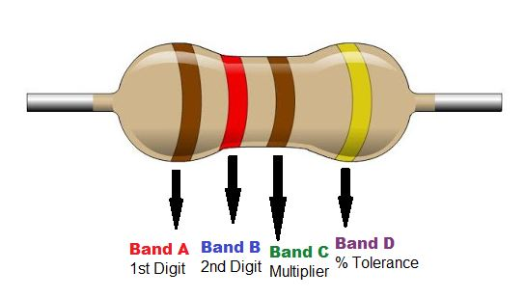
RESSISTORS
A resistor is a passive two-terminal electrical component that implements electrical resistance as a circuit element. Resistors act to reduce current flow, and, at the same time, act to lower voltage levels within circuits. In electronic circuits resistors are used to limit current flow, to adjust signal levels, terminate transmission lines among other uses. Fixed resistors have resistances that only change slightly with temperature, time or operating voltage. Variable resistors can be used to adjust circuit elements such as a volume control or a lamp dimmer or as sensing devices for heat, light, humidity, force, or chemical activity.

Slide 9
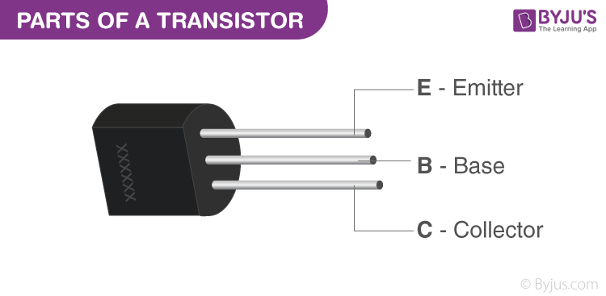
TRANSISTORS
A transistor is a semiconductor device used to amplify and switch electronic signals and electrical power. It is composed of semiconductor material with at least three terminals for connection to an external circuit. A voltage or current applied to one pair of the transistor's terminals changes the current through another pair of terminals. Because the controlled power can be higher than the controlling power, a transistor can amplify a signal. Today, some transistors are packaged individually, but many more are found embedded in integrated circuits.

Slide 10
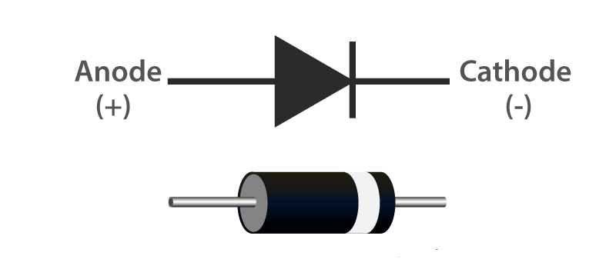
DIODE
A diode is a specialized electronic component with two electrodes called the anode and the cathode. Most diodes are made with semiconductor materials such as silicon, germanium, or selenium. Some diodes are comprised of metal electrodes in a chamber evacuated or filled with a pure elemental gas at low pressure. Diodes can be used as rectifiers, signal limiters, voltage regulators, switches, signal modulators, signal mixers, signal demodulators, and oscillators.

Slide 11
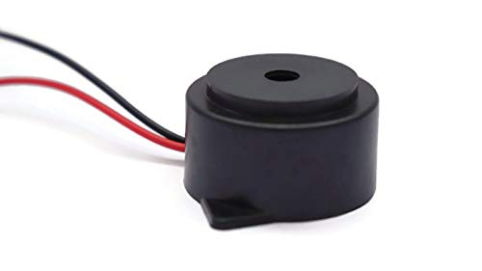
BUZZER
A buzzer or beeper is an audio signaling device, which may be mechanical, electromechanical, or piezoelectric. Typical uses of buzzers and beepers include alarm devices, timers and confirmation of user input such as a mouse click or keystroke.
Piezoelectric
A piezoelectric element may be driven by an oscillating electronic circuit or other audio signal source, driven with a piezoelectric audio amplifier. Sounds commonly used to indicate that a button has been pressed are a click, a ring or a beep.

Slide 12
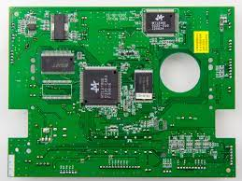
PCB BOARD
A printed circuit board (PCB) mechanically supports and electrically connects electronic components using conductive tracks, pads and other features etched from copper sheets laminated onto a non conductive substrate. PCBs can be single sided, double sided (or multi-layer.Printed circuit boards are used in all but the simplest electronic products. PCBs require the additional design effort to lay out the circuit, but manufacturing and assembly can be automated. Manufacturing circuits with PCBs is cheaper and faster than with other wiring methods as components are mounted and wired with one single part. Furthermore, operator wiring errors are eliminated.

Slide 13
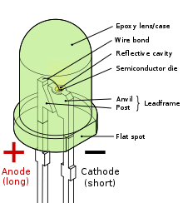
LED
A light-emitting diode (LED) is a two-lead semiconductor light source. It is a pn-junction diode, which emits light when activated. When a suitable voltage is applied to the leads, electrons are able to recombine with electron holes within the device, releasing energy in the form of photons. This effect is called electroluminescence, and the colour of the light corresponding to the energy of the photon is determined by the energy band gap of the semiconductor.

Slide 14
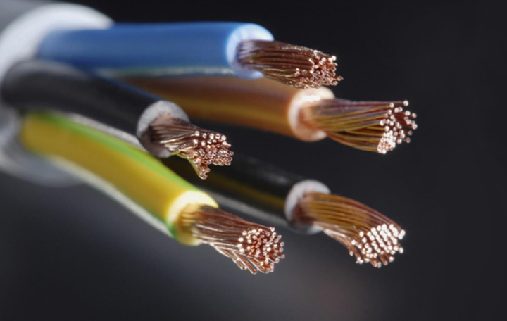
CONNECTING WIRES
A wire is a single, usually cylindrical, flexible strand or rod of metal. Wires are used to bear mechanical loads or electricity and telecommunications signals. Wire is commonly formed by drawing the metal through a hole in a die or draw plate. Wire gauges come in various standard sizes, as expressed in terms of a gauge number. The term wire is also used more loosely to refer to a bundle of such strands, as in 'multi thread wire', which is more correctly termed a wire rope in mechanics, or a cable in electricity.

Slide 15
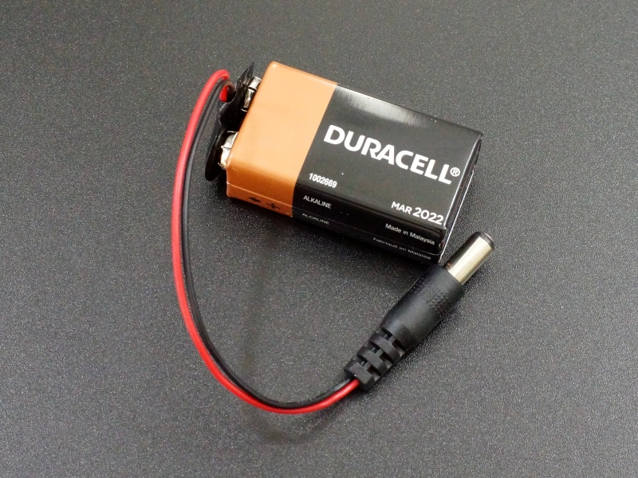
DC POWER BATTERY
An electric battery is a device consisting of one or more electrochemical cells that convert stored chemical energy into electrical energy. Each cell contains a positive terminal, or cathode, and a negative terminal, or anode. Electrolytes allow ions to move between the electrodes and terminals, which allows current to flow out of the battery to perform workA battery consists of some number of voltaic cells. Each cell consists of two half-cells connected in series by a conductive electrolyte containing anions and cations. One half-cell includes electrolyte and the negative electrode, the electrode to which anions migrate; the other half-cell includes electrolyte and the positive electrode to which cations migrate. Redox reactions power the battery. Cations are reduced at the cathode during charging, while anions are oxidized at the anode during discharge. The electrodes are electrically connected by the electrolyte. A separator allows ions to flow between half-cells, but prevents mixing of the electrolytes

Slide 16
OUR GOALS
EXPANSION
POSITIONING
USABILITY
Once its applied and used maybe it will gain popularity and get more expanded.
Positioning of our water level indicator can be good because it can be used in homes as daily use
Our idea will be used efficiently once its an success

Slide 17
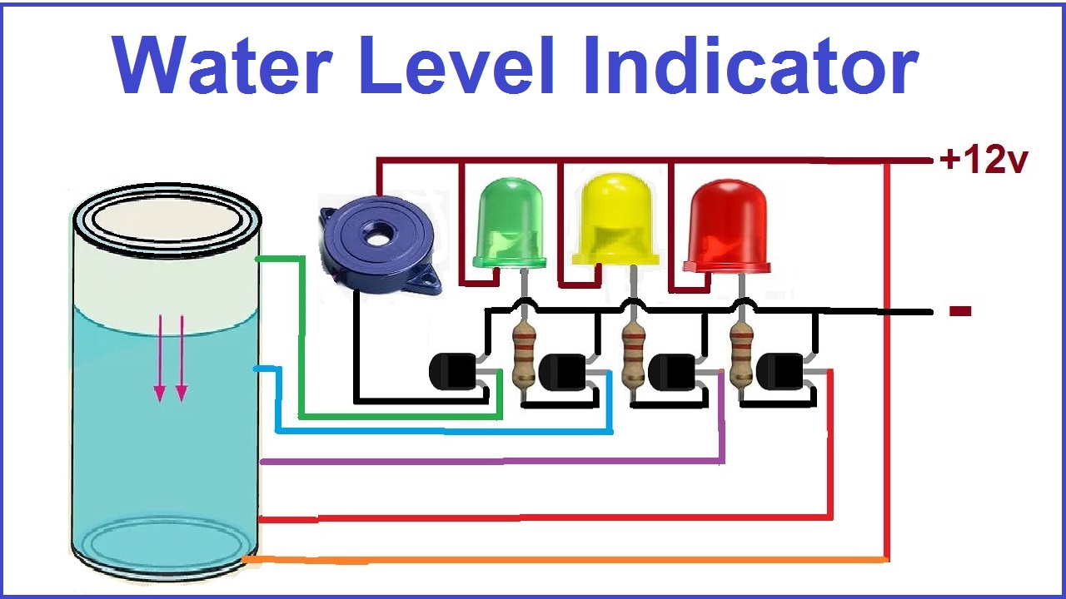
CIRCUIT

Slide 18
CONDITION 1 : WATER IS NOT AVAILABLE
When the tank is empty there is no conductive path between any of the 3 indicating probes and the common probe (which is connected to 9v+ supply) so the transistor base emitter region will not have sufficient biasing voltage hence it remains in cut off region and the output across its collector will be Vc approximately 9v and thus indicates, the tank is empty.

Slide 19
CONDITION 2 : INTERMEDIATE LEVEL
Now as the water starts filling in the tank a conductive path is established between the sensing probes and the common probe and the corresponding transistors get sufficient blasing at their base, they starts conducting and now the outputs will be Vce (i.e. 1.2v-1.8v) approximately which is given to microcontroller. Here the microcontroller is programmed as a priority encoder which detects the highest priority input and displays corresponding water level in the seven segment display. In this project while the water level reaches the 7th level i.e. last but one level along with display in seven segment a discontinuous buzzer is activated which warns user that tank is going to be full soon.

Slide 20
CONDITION 3 : WATER FULL
When the tank becomes full, the top level probe gets the conductive path through water and the corresponding transistor gets into conduction not only displays the level in Five segment display but also activates the continuous buzzer by which user can understand that tank is full and can switch off the motor and save water.

Slide 21
WHY IS IT NEEDED ?
WELL , Some of the advantages that can be covered with our water level indicator are :-
Overflow problems
To prevent wastage of energy
To prevent wastage of water
Observation

Slide 22
APPLICATIONS
Now no need to go on the roof to check the water level.
Can be used to measure underground storage of water.
Water level Indicator works to maintain a constant water level.
(Used in different Plants and Industries)
Alarm starts ringing as soon as tank becomes full.
It helps to check overflow and wastage of water by warning the person when the tank is about to brim.
It can also be used to calculate incoming and out going water in large reservoirs.
It is used to predict the arrival of floods.

Slide 23
REFERENCES
https://www.scribd.com
http://www.electronicsforyou.com
http://www.wikipedia.org
http://www.engineersgarage.com

Slide 24




OUR TEAM
Aditya Prajapati 21SCSE1420051
Prateek Kumar Singh 21SCSE1010884
Nitesh Kumar
21SCSE1010954
Md.Rizwan Ahmad
21SCSE1010811

Slide 25
THANKS!
GROUP 1

